Slide 1
Introduction
cp.shewell@ulster.ac.uk

Slide 2
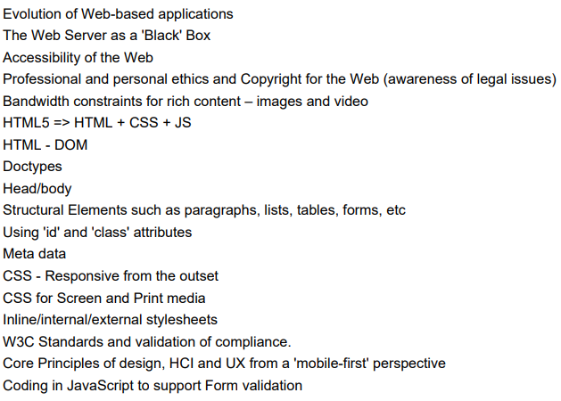
Module Content

Slide 3
Module Information
Module Coordinator – Colin Shewell.
Teaching Staff – Dr. Zeeshan Tariq.
Assessments:
Assignment One – 40% of module mark. This will take the form of a written report. Will take place within November.
Assignment Two – 60% of module mark. This will take the form of a coding assessment. Will take place within December.
Assignment marking will be shared between myself and Dr. Tariq.

Slide 4
Assessments
Assessment One:
Assignment will be undertaken individually
Each student will create a report having reviewed two websites (these will be provided).
Report will focus on analysing how well each website incorporates HCI and design principles.
Report will also contain a range of suggested improvements for each website,

Slide 5
Assessments
Assessment Two:
Assignment will be undertaken individually.
Students will develop a website to collect contact details of potential employers who have requested their CV.
Students will use the knowledge of UX design and apply the principles to develop the HTML structure to take into account accessibility features as well as including coding for validation of user input.
The Web page will host both short and detailed student CVs information and display who has requested copies of their CVs.

Slide 6
Contact
Module issues:
Colin Shewell – https://www.ulster.ac.uk/staff/cp-shewell
cp.shewell@ulster.ac.uk

Slide 7
Questions?

